Slide 1
PROBLEM
Most clinics in Kenya operate on a walk-in first-come-first-served basis. Patients arrive early in the morning and wait for hours without knowing when they will be attended to. This leads to:
Overcrowded waiting rooms
Long unpredictable wait times
Patient frustration and abandonment
Doctors having idle time when no-shows occur
No way to track patient flow or appointment history
The result: Inefficient use of doctor's time, poor patient experience, and disorganized clinic operations.
SOLUTION
The solution: A Clinic Queue Management System that allows patients to book appointment slots in advance, tracks real-time queue position, sends notifications when their turn is near, and manages doctor schedules efficiently. Most clinics in Kenya operate on a walk-in first-come-first-served basis. Patients arrive early in the morning and wait for hours without knowing when they will be attended to.
-time queue position, sends notifications when their turn is near, and manages doctor schedules efficiently.
JUSTIFICATIONS
A mobile application is a valid solution because it provides transparency and mobility. By digitizing the "number," the clinic can communicate real-time delays. This satisfies the user's need for autonomy (waiting where they choose) and the clinic's need for efficiency (a steady stream of ready patients).
REQUIREMENTS ELLICITATION
Constraints — limitations
REQUIREMENT ELICITATION:
This is basically answering — "What does the system need to do?"
Functional Requirements (what the system must do):
Allow patients to register and create a profile
Allow patients to book, reschedule or cancel appointments
Assign patients a real-time queue number and position
Send SMS/notification reminders before appointment time
Allow doctors to view their daily schedule and patient list
Automatically fill cancelled slots from a waitlist
Track patient consultation history and medical records
Generate reports on daily patient flow and doctor utilization
Allow receptionist to manually add walk-in patients
Manage doctor availability and working hours
Non-Functional Requirements (how the system must perform):
Reliability — system must be available during clinic hours
Security — patient data must be protected
Usability — easy to use for both patients and staff
Performance — queue updates must be real-time
Scalability — must handle multiple doctors and departments
MY SQL
Justification for Using MySQL
​ MySQL is valid because:
​Open Source: It fits within a low-cost visibility study as it has no licensing fees for standard use.
​Standardization: It uses standard SQL, making it easy for developers to maintain the system long-term.
​Security: It offers robust user authentication and data encryption, which is critical for the Healthcare domain where patient privacy is paramount.
​By using MySQL, you fulfill the requirement to move from a database dictionary and ER diagram into a functional, physical database design.
[2:09 am, 07/05/2026] +254 110 899704: Requirements Analysis = taking the requirements we listed and organizing them into a clear picture of what the system will do.
System Specification = a formal document that describes exactly what the system is, who uses it, what goes in, what comes out, and its limits.
Think of it like this:
Requirements Analysis asks:
Who uses the system?
What do they need it to do?
System Specification answers:
Here is exactly what the system will do, for who, with what inputs and outputs
[2:10 am, 07/05/2026] +254 110 899704: System Users — who uses it
Inputs — what data goes in
Outputs — what the system produces
MY SQL
Justification for Using MySQL
​ MySQL is valid because:
​Open Source: It fits within a low-cost visibility study as it has no licensing fees for standard use.
​Standardization: It uses standard SQL, making it easy for developers to maintain the system long-term.
​Security: It offers robust user authentication and data encryption, which is critical for the Healthcare domain where patient privacy is paramount.
​By using MySQL, you fulfill the requirement to move from a database dictionary and ER diagram into a functional, physical database design.
[2:09 am, 07/05/2026] +254 110 899704: Requirements Analysis = taking the requirements we listed and organizing them into a clear picture of what the system will do.
System Specification = a formal document that describes exactly what the system is, who uses it, what goes in, what comes out, and its limits.
Think of it like this:
Requirements Analysis asks:
Who uses the system?
What do they need it to do?
System Specification answers:
Here is exactly what the system will do, for who, with what inputs and outputs
[2:10 am, 07/05/2026] +254 110 899704: System Users — who uses it
Inputs — what data goes in
Outputs — what the system produces
SYSTEM PROJECT SPECIFICATION FOR A HEALTH CARE
P
Introduction
This document defines the system specifications for a Healthcare Management System (HMS). The system improves efficiency, accuracy, and accessibility of healthcare services.
Purpose of the System
Manage patient records efficiently
Support appointment scheduling
Enable electronic medical records (EMR)
Improve communication between patients and healthcare providers- Reduce paperwork and manual errors
3. Scope of the System
Patient registration and management- Doctor and staff management
Appointment booking and scheduling
Medical history tracking
Billing and payment processing
Pharmacy and prescription management
4. Functional Requirements
User management (Admin, Doctor, Nurse, Patient)
Patient record management
Appointment scheduling- Medical records storage
Billing system
Pharmacy module
5. Non-Functional Requirements
Security and encryption
Fast response time (2–3 seconds)
Scalability
Reliability (99.9% uptime) - Usability
6. Hardware Requirements
Intel Core i5 or higher
8GB RAM minimum
500GB SSD
Stable internet connection
7. Software Requirements
Windows/Linux Server
MySQL/PostgreSQL
PHP/Python/Java- Apache/Nginx
System Architecture
Client-server architecture with frontend, backend, and database.
Security Requirements
Password encryption
Role-based authentication
SSL security
Regular backups
10. Conclusion
The system improves healthcare delivery by digitizing processes and reducing errors
FEASIBILITY STUDY
1. Cost Feasibility
"Can we afford to build it?"
Yes because:
All software used is free and open source
No expensive hardware required
Only cost is developer time and hosting
Can be hosted locally on WAMP/XAMPP for development
2. Technical Feasibility
"Do we have the technology to build it?"
Yes because:
MySQL database — available and free
MySQL Workbench — available and free
PHP/Web interface — can be built with basic web skills
SMS notifications — can use Africa's Talking API (Kenyan SMS gateway)
All tools are accessible on a standard laptop
24-hour time visibility window.
​Objective: To determine if the transition from problem explanation to physical database design can be completed in a single day.
​Methodology: The report breaks down the 24 hours into specific phases: Requirement Analysis (4hrs), Visibility Study (2hrs), Conceptual Design (6hrs), Physical Design (8hrs), and Documentation (4hrs).
​Technology Assessment: It justifies using MySQL as a rapid development tool to meet this deadline.
​Risk Management: It identifies "scope creep" as the primary risk and suggests focusing only on the core queuing logic to remain feasible.
7. LOGICAL DESIGN — RELATIONSHIPS
# Entity 1 (One) Relationship Entity 2 (Many) Type
1 Patient books Appointment 1:M
2 Doctor has Appointment 1:M
3 Department has Doctor 1:M
4 Department handles Appointment 1:M
5 Appointment generates Queue 1:1
6 Patient has Queue 1:M
7 Patient receives Notification 1:M
8 Appointment triggers Notification 1:M
9 Patient makes Payment 1:M
10 Appointment has Payment 1:1
11 Patient has MedicalRecord 1:M
12 Doctor creates MedicalRecord 1:M
13 Appointment has MedicalRecord 1:1
Clinic has Department 1:M
DESIGN APPOINTMENT
| Table | Column | Data Type | Constraints |
| --- | --- | --- | --- |
| APPOINTMENT | AppointmentID | INT | PK, AUTO_INCREMENT |
| | PatientID | INT | FK → PATIENT |
| | DoctorID | INT | FK → DOCTOR |
| | DepartmentID | INT | FK → DEPARTMENT |
| | AppointmentDate | DATE | |
| | AppointmentTime | TIME | |
| | VisitType | VARCHAR(50) | |
| | Duration | INT | |
| | Status | ENUM('Scheduled', 'Completed', 'Cancelled') | |
| | CreatedAt | TIMESTAMP | DEFAULT CURRENT_TIMESTAMP |
| PATIENT | PatientID | INT | PK, AUTO_INCREMENT |
| | PatientName | VARCHAR(100) | NOT NULL |
| | Gender | ENUM('M', 'F', 'Other') | |
| | DoB | DATE | |
| | BloodGroup | VARCHAR(10) | |
| | PhoneNo | VARCHAR(20) | |
| | Email | VARCHAR(100) | |
| | Address | TEXT | |
| | Allergies | TEXT | |
| | Status | ENUM('Active', 'Inactive') | |
| | RegistrationDate | TIMESTAMP | DEFAULT CURRENT_TIMESTAMP |
| DOCTOR | DoctorID | INT | PK, AUTO_INCREMENT |
| | DoctorName | VARCHAR(100) | NOT NULL |
| | Gender | ENUM('M', 'F', 'Other') | |
| | Qualification | VARCHAR(100) | |
| | Specialization | VARCHAR(50) | |
| | LicenseNo | VARCHAR(50) | UNIQUE |
| | PhoneNo | VARCHAR(20) | |
| | Email | VARCHAR(100) | |
| | DepartmentID | INT | FK → DEPARTMENT |
| | AvgConsultationTime | INT | |
| | ConsultationFee | DECIMAL(10,2) | |
| | Status | ENUM('Active', 'Inactive') | |
| DEPARTMENT | DepartmentID | INT | PK, AUTO_INCREMENT |
| | DepartmentName | VARCHAR(50) | UNIQUE, NOT NULL |
| | Description | TEXT | |
| | Status | ENUM('Active', 'Inactive') | |
| QUEUE | QueueID | INT | PK, AUTO_INCREMENT |
| | AppointmentID | INT | FK → APPOINTMENT |
| | PatientID | INT | FK → PATIENT |
| | QueueNumber | INT | |
| | QueueDate | DATE | |
| | EstimatedTime | TIME | |
| | ActualTime | TIME | |
| NOTIFICATION | NotificationID | INT | PK, AUTO_INCREMENT |
| | PatientID | INT | FK → PATIENT |
| | AppointmentID | INT | FK → APPOINTMENT |
| | Message | TEXT | |
| | SentDate | DATE | |
| | SentTime | TIME | |
| | NotificationType | ENUM('SMS', 'Email', 'App') | |
| PAYMENT | PaymentID | INT | PK, AUTO_INCREMENT |
| | PatientID | INT | FK → PATIENT |
| | AppointmentID | INT | FK → APPOINTMENT |
| | Amount | DECIMAL(10,2) | |
| | PaymentDate | DATE | |
| | PaymentMethod | ENUM('Cash', 'M-Pesa', 'Card') | |
| | TransactionNo | VARCHAR(50) | |
| | Status | ENUM('Paid', 'Pending', 'Partial') | |
| MEDICALRECORD | RecordID | INT | PK, AUTO_INCREMENT |
| | PatientID | INT | FK → PATIENT |
| | DoctorID | INT | FK → DOCTOR |
| | AppointmentID | INT | FK → APPOINTMENT |
| | Diagnosis | TEXT | |
| | Prescription | TEXT | |
| | Notes | TEXT | |
| | Weight | DECIMAL(5,2) | |
| | BloodPressure | VARCHAR(20) | |
| | Temperature | DECIMAL(4,2) | |
| | RecordDate | DATE | |
| CLINIC | ClinicID | INT | PK, AUTO_INCREMENT |
| | ClinicName | VARCHAR(100) | NOT NULL |
| | Location | VARCHAR(100) | |
| | PhoneNo | VARCHAR(20) | |
| | Email | VARCHAR(100) | |
| | OpeningTime | TIME | |
| | ClosingTime | TIME | |
| | Status | ENUM('A
DATA DICTIONARY
Entity Attribute Data Type Size Constraint Description
1. APPOINTMENT (Central Entity)
1 Appointment AppointmentID INT - PK Unique appointment ID
2 Appointment PatientID INT - FK Links to Patient
3 Appointment DoctorID INT - FK Links to Doctor
4 Appointment DepartmentID INT - FK Links to Department
5 Appointment AppointmentDate DATE - NOT NULL Date of appointment
6 Appointment AppointmentTime TIME - NOT NULL Time of appointment
7 Appointment VisitType VARCHAR 30 NOT NULL Routine/New/Emergency
8 Appointment Duration INT - NULL Duration in minutes
9 Appointment Status VARCHAR 20 NOT NULL Confirmed/Completed/Cancelled/No-Show
10 Appointment CreatedAt DATETIME - NOT NULL When booking was made
2. PATIENT
1 Patient PatientID INT - PK Unique patient ID
2 Patient PatientName VARCHAR 100 NOT NULL Full name
3 Patient Gender CHAR 1 NOT NULL M or F
4 Patient DoB DATE - NOT NULL Date of birth
5 Patient BloodGroup VARCHAR 5 NULL e.g. A+, O-
6 Patient PhoneNo VARCHAR 15 NOT NULL Phone number
7 Patient Email VARCHAR 100 NULL Email address
8 Patient Address VARCHAR 100 NULL Physical address
9 Patient Allergies VARCHAR 200 NULL Known allergies
10 Patient Status VARCHAR 20 NOT NULL Active/Inactive
11 Patient RegistrationDate DATE - NOT NULL Date of registration
3. DOCTOR
1 Doctor DoctorID INT - PK Unique doctor ID
2 Doctor DoctorName VARCHAR 100 NOT NULL Full name
3 Doctor Gender CHAR 1 NOT NULL M or F
4 Doctor Qualification VARCHAR 50 NOT NULL e.g. MBChB
5 Doctor Specialization VARCHAR 50 NULL Area of specialization
6 Doctor LicenseNo VARCHAR 20 UNIQUE Medical license number
7 Doctor PhoneNo VARCHAR 15 NOT NULL Phone number
8 Doctor Email VARCHAR 100 NULL Email address
9 Doctor DepartmentID INT - FK Links to Department
10 Doctor AvgConsultationTime INT - NULL Average time per patient (mins)
11 Doctor ConsultationFee DECIMAL 10,2 NOT NULL Fee per consultation
12 Doctor Status VARCHAR 20 NOT NULL Active/Inactive
4. DEPARTMENT
1 Department DepartmentID INT - PK Unique department ID
2 Department DepartmentName VARCHAR 50 NOT NULL e.g. General, Dental
3 Department Description VARCHAR 100 NULL Department description
4 Department Status VARCHAR 20 NOT NULL Active/Inactive
5. CLINIC
1 Clinic ClinicID INT - PK Unique clinic ID
2 Clinic ClinicName VARCHAR 100 NOT NULL Name of clinic
3 Clinic Location VARCHAR 100 NOT NULL Physical location
4 Clinic PhoneNo VARCHAR 15 NOT NULL Contact number
5 Clinic Email VARCHAR 100 NULL Email address
6 Clinic OpeningTime TIME - NOT NULL Opening time
7 Clinic ClosingTime TIME - NOT NULL Closing time
8 Clinic Status VARCHAR 20 NOT NULL Active/Inactive
6. QUEUE
1 Queue QueueID INT - PK Unique queue ID
2 Queue AppointmentID INT - FK Links to Appointment
3 Queue PatientID INT - FK Links to Patient
4 Queue QueueNumber INT - NOT NULL Patient's queue number
5 Queue QueueDate DATE - NOT NULL Date of queue
6 Queue EstimatedTime TIME - NULL Estimated call time
7 Queue ActualTime TIME - NULL Actual call time
8 Queue Status VARCHAR 20 NOT NULL Waiting/Called/Completed
7. NOTIFICATION
1 Notification NotificationID INT - PK Unique notification ID
2 Notification PatientID INT - FK Links to Patient
3 Notification AppointmentID INT - FK Links to Appointment
4 Notification Message VARCHAR 200 NOT NULL Notification message
5 Notification SentDate DATE - NOT NULL Date sent
6 Notification SentTime TIME - NOT NULL Time sent
7 Notification NotificationType VARCHAR 30 NOT NULL Reminder/Alert/Confirmation
8 Notification Status VARCHAR 20 NOT NULL Sent/Pending/Failed
8. PAYMENT
1 Payment PaymentID INT - PK Unique payment ID
2 Payment PatientID INT - FK Links to Patient
3 Payment AppointmentID INT - FK Links to Appointment
4 Payment Amount DECIMAL 10,2 NOT NULL Amount paid
5 Payment PaymentDate DATE - NOT NULL Date of payment
6 Payment PaymentMethod VARCHAR 30 NOT NULL Cash/MPesa/Card
7 Payment TransactionNo VARCHAR 50 UNIQUE Transaction reference
Payment Status VARCHAR 20 NOT NULL Paid/Pending/Failed
10 MedicalRecord Temperature DECIMAL 4,1 NULL Body temperature °C
11 MedicalRecord RecordDa
MEDICALRECORD
1 MedicalRecord RecordID INT - PK Unique record ID
2 MedicalRecord PatientID INT - FK Links to Patient
3 MedicalRecord DoctorID INT - FK Links to Doctor
4 MedicalRecord AppointmentID INT - FK Links to Appointment
5 MedicalRecord Diagnosis TEXT - NULL Doctor's diagnosis
6 MedicalRecord Prescription TEXT - NULL Prescribed medication
7 MedicalRecord Notes TEXT - NULL Additional notes
8 MedicalRecord Weight DECIMAL 5,2 NULL Patient weight in kg
MedicalRecord BloodPressure VARCHAR 20 NULL e.g. 120/80
ER DIAGRAM
v

Slide 2
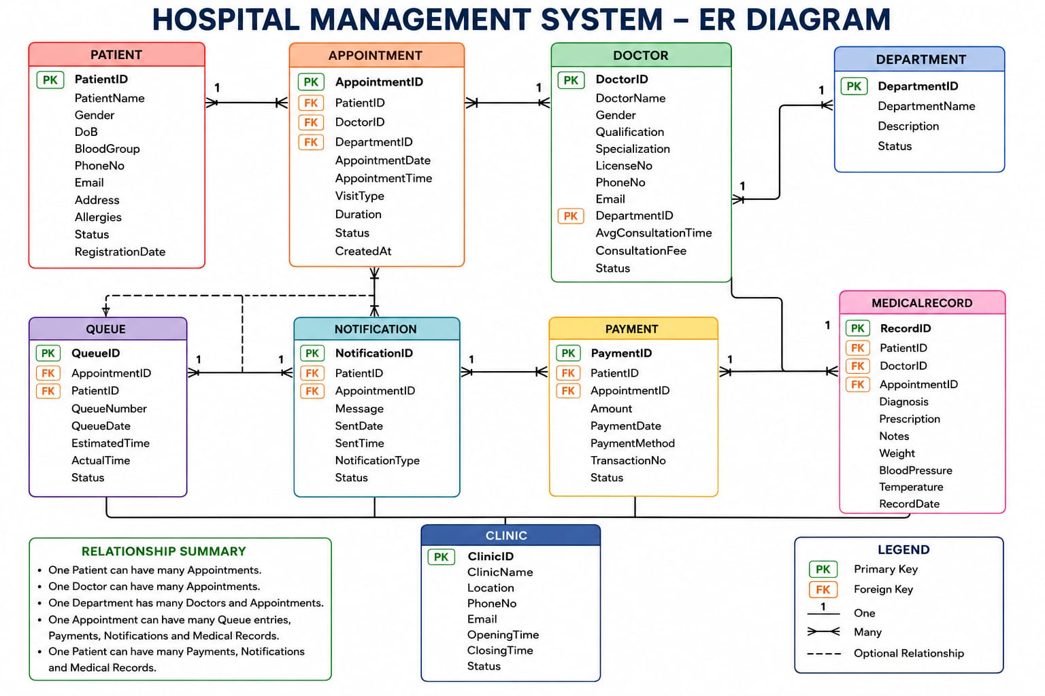

Slide 6
MEDICALRECORD
1 MedicalRecord RecordID INT - PK Unique record ID
2 MedicalRecord PatientID INT - FK Links to Patient
3 MedicalRecord DoctorID INT - FK Links to Doctor
4 MedicalRecord AppointmentID INT - FK Links to Appointment
5 MedicalRecord Diagnosis TEXT - NULL Doctor's diagnosis
6 MedicalRecord Prescription TEXT - NULL Prescribed medication
7 MedicalRecord Notes TEXT - NULL Additional notes
8 MedicalRecord Weight DECIMAL 5,2 NULL Patient weight in kg
9 MedicalRecord BloodPressure VARCHAR 20 NULL e.g. 120/80

Slide 7
MEDICAL RECORD| Column | Data Type | Constraints || --- | --- | --- || RecordID | INT | PK, AUTO_INCREMENT || PatientID | INT | FK → PATIENT || DoctorID | INT | FK → DOCTOR || AppointmentID | INT | FK → APPOINTMENT || Diagnosis | TEXT | || Prescription | TEXT | || Notes | TEXT | || Weight | DECIMAL(5,2) | || BloodPressure | VARCHAR(20) | || Temperature | DECIMAL(4,1) | || RecordDate | DATE | DEFAULT CURRENT_DATE |

